Slide 1

Simulation
F
MODULE
PowerPoint presentation to accompany
Heizer and Render
Operations Management, Eleventh Edition
Principles of Operations Management, Ninth Edition
PowerPoint slides by Jeff Heyl
© 2014 Pearson Education, Inc.

Slide 2
Outline
What Is Simulation?
Advantages and Disadvantages of Simulation
Monte Carlo Simulation
Simulation and Inventory Analysis

Slide 3
Learning Objectives
When you complete this chapter you should be able to:
List the advantages and disadvantages of modeling with simulation
Perform the five steps in a Monte Carlo simulation
Simulate an inventory problem
Use Excel spreadsheets to create a simulation

Slide 4
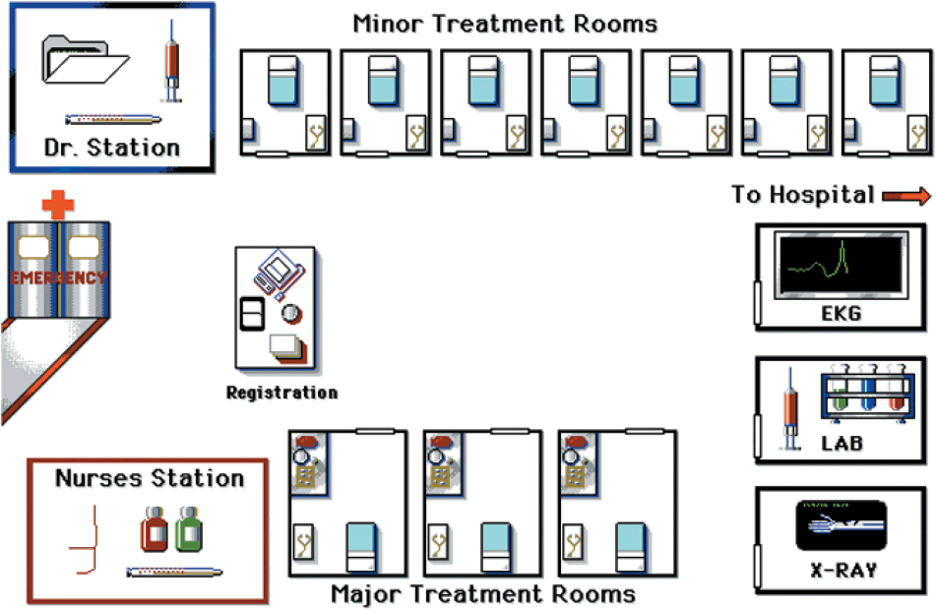
Computer Simulation
Notes:
This slide provides some reasons that capacity is an issue. The following slides guide a discussion of capacity.

Slide 5
What is Simulation?
An attempt to duplicate the features, appearance, and characteristics of a real system
  To imitate a real-world situation mathematically
  To study its properties and operating characteristics
  To draw conclusions and make action decisions based on the results of the simulation
Notes:
This slide provides some reasons that capacity is an issue. The following slides guide a discussion of capacity.

Slide 6
Simulation Applications
TABLE F.1 | Some Applications of Simulation
Ambulance location and dispatching |  | Bus scheduling
Assembly-line balancing |  | Design of library operations
Parking lot and harbor design |  | Taxi, truck, and railroad dispatching
Distribution system design |  | Production facility scheduling
Scheduling aircraft |  | Plant layout
Labor-hiring decisions |  | Capital investments
Personnel scheduling |  | Production scheduling
Traffic-light timing |  | Sales forecasting
Voting pattern prediction |  | Inventory planning and control
Notes:
This slide can be used to frame a discussion of capacity.
Points to be made might include:
- capacity definition and measurement is necessary if we are to develop a production schedule
- while a process may have “maximum” capacity, many factors prevent us from achieving that capacity on a continuous basis.
Students should be asked to suggest factors which might prevent one from achieving maximum capacity.

Slide 7
To Use Simulation
Define the problem
Introduce the important variables associated with the problem
Construct a numerical model
Set up possible courses of action for testing by specifying values of variables
Run the experiment
Consider the results (possibly modifying the model or changing data inputs)
Decide what course of action to take

Slide 8
The
Process of Simulation
Define problem
Introduce variables
Construct model
Specify values
of variables
Conduct simulation
Examine results
Figure F.1
Select best course
Notes:
This slide can be used to frame a discussion of capacity.
Points to be made might include:
- capacity definition and measurement is necessary if we are to develop a production schedule
- while a process may have “maximum” capacity, many factors prevent us from achieving that capacity on a continuous basis.
Students should be asked to suggest factors which might prevent one from achieving maximum capacity.

Slide 9
Advantages of Simulation
Can be used to analyze large and complex real-world situations that cannot be solved by conventional models
Real-world complications can be included that most OM models cannot permit
“Time compression” is possible
Notes:
This slide can be used to frame a discussion of capacity.
Points to be made might include:
- capacity definition and measurement is necessary if we are to develop a production schedule
- while a process may have “maximum” capacity, many factors prevent us from achieving that capacity on a continuous basis.
Students should be asked to suggest factors which might prevent one from achieving maximum capacity.

Slide 10
Advantages of Simulation
Allows “what-if” types of questions and different policy decisions can be quickly evaluated
Does not interfere with real-world systems
Notes:
This slide can be used to frame a discussion of capacity.
Points to be made might include:
- capacity definition and measurement is necessary if we are to develop a production schedule
- while a process may have “maximum” capacity, many factors prevent us from achieving that capacity on a continuous basis.
Students should be asked to suggest factors which might prevent one from achieving maximum capacity.

Slide 11
Disadvantages of Simulation
Can take a long time to develop
It is a repetitive approach that may produce different solutions in repeated runs
Managers must generate all of the conditions and constraints for solutions they want to examine
Each simulation model is unique
Notes:
This slide can be used to frame a discussion of capacity.
Points to be made might include:
- capacity definition and measurement is necessary if we are to develop a production schedule
- while a process may have “maximum” capacity, many factors prevent us from achieving that capacity on a continuous basis.
Students should be asked to suggest factors which might prevent one from achieving maximum capacity.

Slide 12
Monte Carlo Simulation
The Monte Carlo method may be used when the model contains elements that exhibit chance in their behavior
  Set up probability distributions for important variables
  Build a cumulative probability distribution for each variable
  Establish an interval of random numbers for each variable
  Generate random numbers
  Simulate a series of trials
Notes:
This slide can be used to frame a discussion of capacity.
Points to be made might include:
- capacity definition and measurement is necessary if we are to develop a production schedule
- while a process may have “maximum” capacity, many factors prevent us from achieving that capacity on a continuous basis.
Students should be asked to suggest factors which might prevent one from achieving maximum capacity.

Slide 13
Probability of Demand
TABLE F.2 | Demand for Barry’s Auto Tire
(1) DEMAND FOR TIRES |  | (2) FREQUENCY |  |  | (3) PROBABILITY OF OCCURRENCE |  |  | (4) CUMULATIVE PROBABILITY
0 |  |  | 10 |  |  | 10/200 = .05 |  | .05
1 |  |  | 20 |  |  | 20/200 = .10 |  | .15
2 |  |  | 40 |  |  | 40/200 = .20 |  | .35
3 |  |  | 60 |  |  | 60/200 = .30 |  | .65
4 |  |  | 40 |  |  | 40/200 = .20 |  | .85
5 |  |  | 30 |  |  | 30/ 200 = .15 |  | 1.00
 |  |  | 200 | days |  | 200/200 = 1.00
Notes:
This slide can be used to frame a discussion of capacity.
Points to be made might include:
- capacity definition and measurement is necessary if we are to develop a production schedule
- while a process may have “maximum” capacity, many factors prevent us from achieving that capacity on a continuous basis.
Students should be asked to suggest factors which might prevent one from achieving maximum capacity.

Slide 14
Assignment of Random Numbers
TABLE F.3 |  | The Assignment of Random-Number Intervals for Barry’s Auto Tire
DAILY DEMAND | PROBABILITY |  | CUMULATIVE PROBABILITY | INTERVAL OF RANDOM NUMBERS
0 | .05 |  | .05 | 01 through 05
1 | .10 |  | .15 | 06 through 15
2 | .20 |  | .35 | 16 through 35
3 | .30 |  | .65 | 36 through 65
4 | .20 |  | .85 | 66 through 85
5 | .15 |  | 1.00 | 86 through 00
Notes:
This slide can be used to frame a discussion of capacity.
Points to be made might include:
- capacity definition and measurement is necessary if we are to develop a production schedule
- while a process may have “maximum” capacity, many factors prevent us from achieving that capacity on a continuous basis.
Students should be asked to suggest factors which might prevent one from achieving maximum capacity.

Slide 15
Table of Random Numbers
TABLE F.4 |  | Table of 2-Digit Random Numbers
52 | 50 |  | 60 | 52 | 05
37 | 27 |  | 80 | 69 | 34
82 | 45 |  | 53 | 33 | 55
69 | 81 |  | 69 | 32 | 09
98 | 66 |  | 37 | 30 | 77
96 | 74 |  | 06 | 48 | 08
33 | 30 |  | 63 | 88 | 45
50 | 59 |  | 57 | 14 | 84
88 | 67 |  | 02 | 02 | 84
90 | 60 |  | 94 | 83 | 77
Notes:
This slide can be used to frame a discussion of capacity.
Points to be made might include:
- capacity definition and measurement is necessary if we are to develop a production schedule
- while a process may have “maximum” capacity, many factors prevent us from achieving that capacity on a continuous basis.
Students should be asked to suggest factors which might prevent one from achieving maximum capacity.

Slide 16
Simulation Example 1
DAY NUMBER | RANDOM NUMBER | SIMULATED DAILY DEMAND
1 | 52 |  | 3
2 | 37 |  | 3
3 | 82 |  | 4
4 | 69 |  | 4
5 | 98 |  | 5
6 | 96 |  | 5
7 | 33 |  | 2
8 | 50 |  | 3
9 | 88 |  | 5
10 | 90 |  | 5
 |  |  | 39 | Total 10-day demand
 |  |  | 3.9 | Average
Select random numbers from Table F.3
Notes:
This slide can be used to frame a discussion of capacity.
Points to be made might include:
- capacity definition and measurement is necessary if we are to develop a production schedule
- while a process may have “maximum” capacity, many factors prevent us from achieving that capacity on a continuous basis.
Students should be asked to suggest factors which might prevent one from achieving maximum capacity.

Slide 17
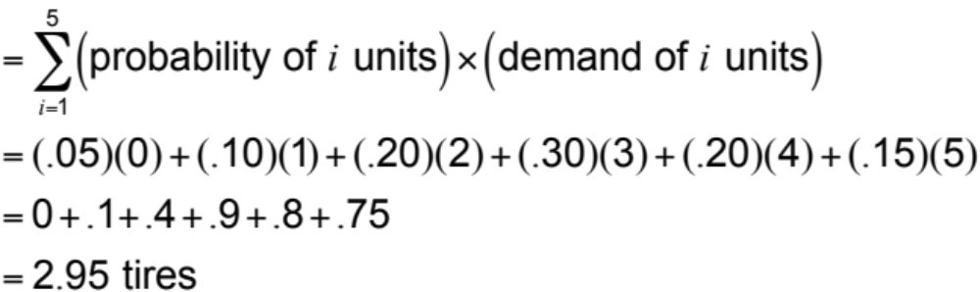
Simulation Example 1
DAY NUMBER | RANDOM NUMBER | SIMULATED DAILY DEMAND
1 | 52 |  | 3
2 | 37 |  | 3
3 | 82 |  | 4
4 | 69 |  | 4
5 | 98 |  | 5
6 | 96 |  | 5
7 | 33 |  | 2
8 | 50 |  | 3
9 | 88 |  | 5
10 | 90 |  | 5
 |  |  | 39 | Total 10-day demand
 |  |  | 3.9 | Average
Expected
demand
Select random numbers from Table F.3
Notes:
This slide can be used to frame a discussion of capacity.
Points to be made might include:
- capacity definition and measurement is necessary if we are to develop a production schedule
- while a process may have “maximum” capacity, many factors prevent us from achieving that capacity on a continuous basis.
Students should be asked to suggest factors which might prevent one from achieving maximum capacity.

Slide 18
Simulation and Inventory Analysis
TABLE F.5 |  | Probabilities and Random-Number Intervals for Daily Ace Drill Demand
(1) DEMAND FOR ACE DRILL | (2) FREQUENCY |  |  | (3) PROBABILITY |  |  | (4) CUMULATIVE PROBABILITY | (5) INTERVAL OF RANDOM NUMBERS
0 |  | 15 |  |  | .05 |  | .05 | 01 through 05
1 |  | 30 |  |  | .10 |  | .15 | 06 through 15
2 |  | 60 |  |  | .20 |  | .35 | 16 through 35
3 |  | 120 |  |  | .40 |  | .75 | 36 through 75
4 |  | 45 |  |  | .15 |  | .90 | 76 through 90
5 |  | 30 |  |  | .10 |  | 1.00 | 91 through 00
 |  | 300 | days |  | 1.00
Notes:
This slide can be used to frame a discussion of capacity.
Points to be made might include:
- capacity definition and measurement is necessary if we are to develop a production schedule
- while a process may have “maximum” capacity, many factors prevent us from achieving that capacity on a continuous basis.
Students should be asked to suggest factors which might prevent one from achieving maximum capacity.

Slide 19
Inventory Simulation
TABLE F.6 |  | Probabilities and Random-Number Intervals for Reorder Lead Time
(1) LEAD TIME (DAYS) | (2) FREQUENCY |  |  |  | (3) PROBABILITY |  |  | (4) CUMULATIVE PROBABILITY | (5) RANDOM-NUMBER INTERVAL
1 |  |  | 10 |  |  | .20 |  | .20 | 01 through 20
2 |  |  | 25 |  |  | .50 |  | .70 | 21 through 70
3 |  |  | 15 |  |  | .30 |  | 1.00 | 71 through 00
 |  |  | 50 | orders |  | 1.00
Notes:
This slide can be used to frame a discussion of capacity.
Points to be made might include:
- capacity definition and measurement is necessary if we are to develop a production schedule
- while a process may have “maximum” capacity, many factors prevent us from achieving that capacity on a continuous basis.
Students should be asked to suggest factors which might prevent one from achieving maximum capacity.

Slide 20
Inventory Simulation
Begin each simulation day by checking to see if ordered inventory has arrived. If it has, increase current inventory by the quantity ordered.
Generate daily demand using probability distribution and random numbers.
Compute ending inventory. If on-hand is insufficient to meet demand, satisfy as much as possible and note lost sales.
Determine whether the day's ending inventory has reached the reorder point. If it has, and there are no outstanding orders, place an order. Choose lead time using probability distribution and random numbers.
Notes:
This slide can be used to frame a discussion of capacity.
Points to be made might include:
- capacity definition and measurement is necessary if we are to develop a production schedule
- while a process may have “maximum” capacity, many factors prevent us from achieving that capacity on a continuous basis.
Students should be asked to suggest factors which might prevent one from achieving maximum capacity.

Slide 21
Inventory Simulation
TABLE F.7 |  | Simkin Hardware’s First Inventory Simulation. Order Quantity = 10 Units; Reorder Point = 5 Units
(1) DAY | (2) UNITS RECEIVE | (3) BEGIN INV | (4) RANDOM NUMBER | (5) DEMAND | (6) ENDING INV |  |  | (7) LOST SALES |  |  | (8) ORDER? | (9) RANDOM NUMBER | (10) LEAD TIME
1 |  | 10 | 06 | 1 |  | 9 |  |  | 0 |  | No
2 | 0 | 9 | 63 | 3 |  | 6 |  |  | 0 |  | No
3 | 0 | 6 | 57 | 3 |  | 3 |  |  | 0 |  | Yes | 02 | 1
4 | 0 | 3 | 94 | 5 |  | 0 |  |  | 2 |  | No
5 | 10 | 10 | 52 | 3 |  | 7 |  |  | 0 |  | No
6 | 0 | 7 | 69 | 3 |  | 4 |  |  | 0 |  | Yes | 33 | 2
7 | 0 | 4 | 32 | 2 |  | 2 |  |  | 0 |  | No
8 | 0 | 2 | 30 | 2 |  | 0 |  |  | 0 |  | No
9 | 10 | 10 | 48 | 3 |  | 7 |  |  | 0 |  | No
10 | 0 | 7 | 88 | 4 |  | 3 |  |  | 0 |  | Yes | 14 | 1
 |  |  |  | Totals: |  | 41 |  |  | 2
Notes:
This slide can be used to frame a discussion of capacity.
Points to be made might include:
- capacity definition and measurement is necessary if we are to develop a production schedule
- while a process may have “maximum” capacity, many factors prevent us from achieving that capacity on a continuous basis.
Students should be asked to suggest factors which might prevent one from achieving maximum capacity.

Slide 22
Inventory Simulation
Average
ending =
inventory
41 total units
10 days
= 4.1 units/day
Average
lost =
sales
2 sales lost
10 days
= .2 unit/day
Average number of orders placed
3 orders
10 days
= = .3 order/day
Notes:
This slide can be used to frame a discussion of capacity.
Points to be made might include:
- capacity definition and measurement is necessary if we are to develop a production schedule
- while a process may have “maximum” capacity, many factors prevent us from achieving that capacity on a continuous basis.
Students should be asked to suggest factors which might prevent one from achieving maximum capacity.

Slide 23
Using Software in Simulation
Computers are critical in simulating complex tasks
General-purpose languages - BASIC, C++
Special-purpose simulation languages - GPSS, SIMSCRIPT
  Require less programming time for large simulations
  Usually more efficient and easier to check for errors
  Random-number generators are built in
Notes:
This slide can be used to frame a discussion of capacity.
Points to be made might include:
- capacity definition and measurement is necessary if we are to develop a production schedule
- while a process may have “maximum” capacity, many factors prevent us from achieving that capacity on a continuous basis.
Students should be asked to suggest factors which might prevent one from achieving maximum capacity.

Slide 24
Using Software in Simulation
Commercial simulation programs are available for many applications - Extend, Modsim, Witness, MAP/1, Enterprise Dynamics, Simfactory, ProModel, Micro Saint, ARENA
Spreadsheets such as Excel can be used to develop some simulations
Notes:
This slide can be used to frame a discussion of capacity.
Points to be made might include:
- capacity definition and measurement is necessary if we are to develop a production schedule
- while a process may have “maximum” capacity, many factors prevent us from achieving that capacity on a continuous basis.
Students should be asked to suggest factors which might prevent one from achieving maximum capacity.

Slide 25
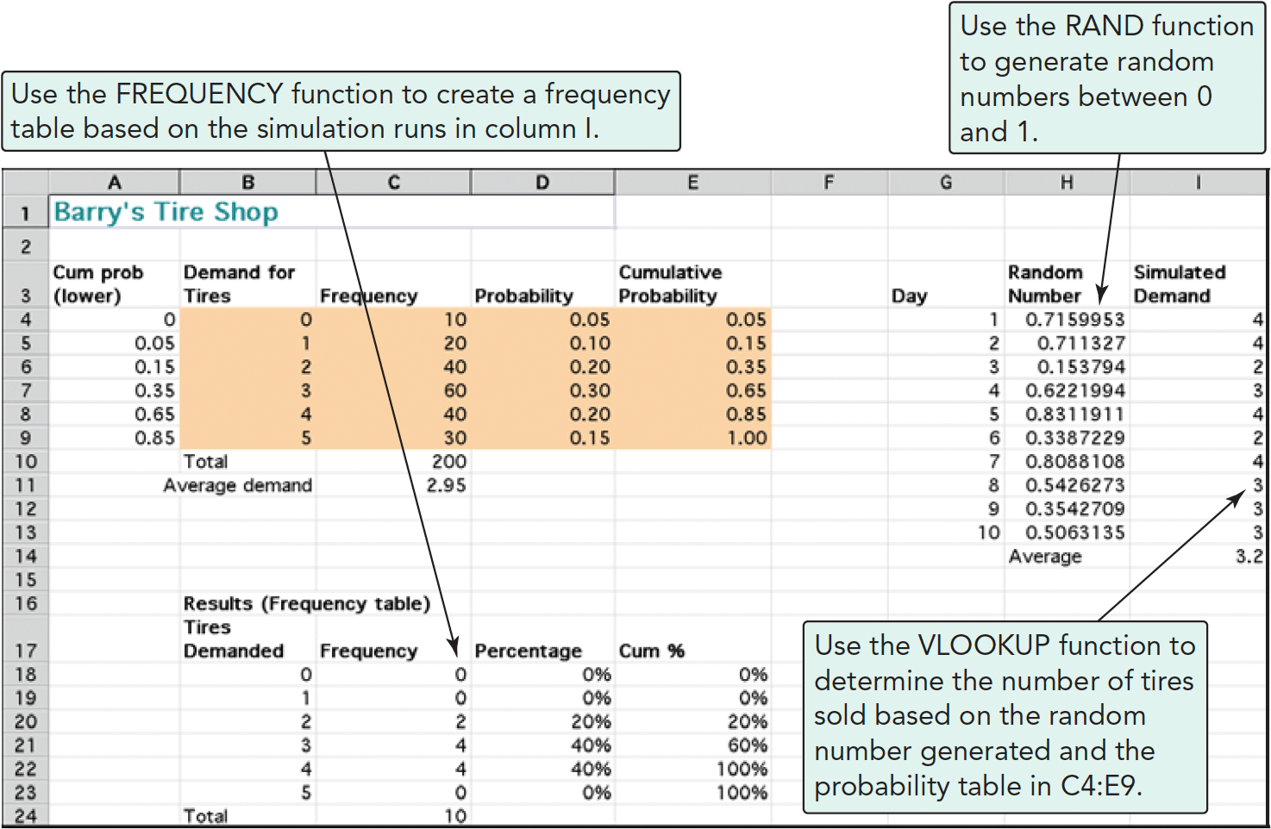
Using Software in Simulation
Program F.1
Notes:
This slide can be used to frame a discussion of capacity.
Points to be made might include:
- capacity definition and measurement is necessary if we are to develop a production schedule
- while a process may have “maximum” capacity, many factors prevent us from achieving that capacity on a continuous basis.
Students should be asked to suggest factors which might prevent one from achieving maximum capacity.

Slide 26

All rights reserved. No part of this publication may be reproduced, stored in a retrieval system, or transmitted, in any form or by any means, electronic, mechanical, photocopying, recording, or otherwise, without the prior written permission of the publisher.
Printed in the United States of America.

